Slide 1
Exception Handling
By: Harshita Agrawal

Slide 2
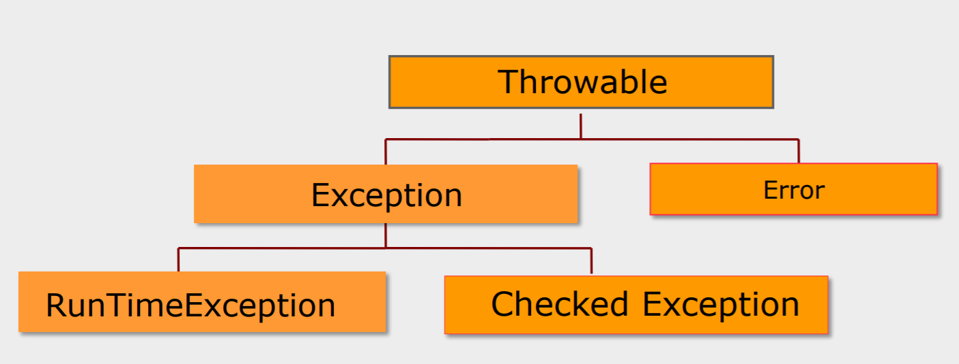
What is an Exception?
An exception is an unexpected event that occurs during runtime and causes normal program flow to be disrupted.
Some common examples:
Divide by zero errors
Accessing the elements of an array beyond its range
Invalid input
Opening a non-existent file

Slide 3
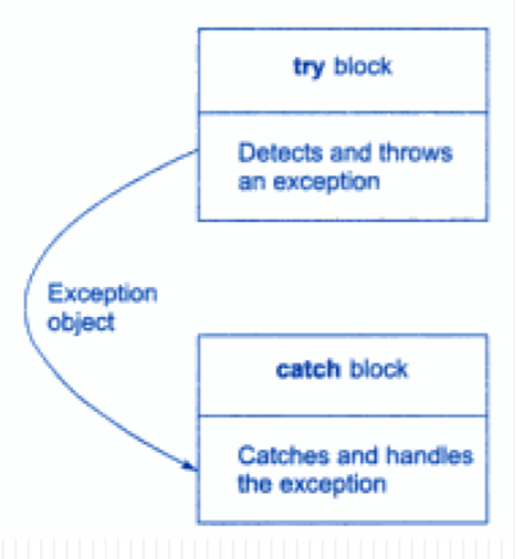
When the try block throws an exception the program control leaves the try block and enters the catch statement of the catch block.
If the type of object thrown matches the arg type in the catch statement the catch block is executed.
Otherwise the program is terminated with the help of abort() function.

Slide 4
Catching Exception Using try and catch
The general form of exception handling block:
try {
//code to be monitored.
}
catch (Exception1 e1 ) {
//exception handler for Type Exception1
}
catch (Exception2 e2 ) {
//exception handler for Type Exception2
}
finally {
// code that must be executed.
}

Slide 5
Exception Matching
When an exception is thrown, the exception handling system looks through the “nearest” handlers in the order they are written. When it finds a match, the exception is considered handled, and no further searching occurs.
Matching an exception doesn’t require a perfect match between the exception and its handler. A derived-class object will match a handler for the base class

Slide 6
Example of exception
class ThrowDemo { void proc() {
try {
throw new FileNotFoundException (“From Exception”);
} catch(FileNotFoundException e) {
System.out.println("Caught inside demoproc."); throw e; // rethrow the exception
} }
public static void main(String args[]) {
ThrowDemo t=new ThrowDemo();
try {
t.proc();
} catch(FileNotFoundException e) { System.out.println("Recaught: " + e);
}
} }

Slide 7
Thank you

